Slide 1

New Trends in Energy Desalination
Constantinos Taliotis
taliotis@kth.se
Introductory lecture – Energy commodities and technologies
This work by OpTIMUS.community is licensed under the Creative Commons Attribution 4.0 International License. To view a copy of this license, visit http://creativecommons.org/licenses/by/4.0/.
Notes:
Good afternoon and welcome to the lecture on “…”.
Introduce yourself and your research, field of expertise

Slide 2
Motivation for energy technology research and development
Notes:
To start with, it’s important to understand why efforts are put into improving the structure of the current energy system. For instance, even in Sweden where the share of renewables is very high in comparison with the rest of the world (or even EU), there are efforts to transform the energy system into completely carbon free in the next few decades. This is not trivial, considering the fact that the transport sector is heavily reliant on oil products.

Slide 3
Why innovate?
Energy Efficiency – Cost Efficiency
The cheapest kWh is a kWh not generated
Making the best out of the available resources
Energy Security
Resilient and robust energy system
Taking advantage of domestic energy sources leads to reduced reliance on fuel imports
Climate Change
Transition to low-carbon economy
Health and environment
Reduced emission of air and water pollutants that adversely affect health
Notes:
>Moving on, one important aspect to improve on is energy efficiency, which directly corresponds to a more cost-efficient system. In terms of electricity generation, the cheapest kWh is a kWh not generated – this can be achieved for instance with better thermal insulation, thus reducing the need for heating or cooling.
>Furthermore, technology improvements help in strengthening the resilience and robustness of the energy system, as for example it can withstand outages more effectively. In addition, by maximizing the use of domestic energy sources, import dependency is reduced and disruptions in fuel supply and price fluctuations are avoided. For instance, EV owners charging their vehicles with electricity from domestic solar and wind technologies, remain unaffected in the case of sudden surges in oil price.
>In addition, future deployment of technologies that help reduce CO2 emissions is significant. Finally, emissions of air and water pollutants that adversely affect health public health and the environment can be reduced.
All of these aspects are connected to each of the technology options we will discuss today

Slide 4
Water Desalination
Notes:
BREAK HERE

Slide 5
Water availability - 2011
Source: Maplecroft, Water Stress Index 2011
Notes:
As a short intro to this section, it is important to show how diverse water availability is across the world. This figure shows the variation in water stress in different regions.
It is interesting to see that great variation exists even within certain countries (e.g. Australia, India, Argentina, South Africa and Spain). Also, specific areas of the world, such as Middle East and North Africa are in extreme stress.

Slide 6
Projections of Global Water Stress
Source: Philippe
Rekacewicz (Le Monde diplomatique), February 2006
Notes:
Going further, it is important to note that climate projections indicate that the situation will exacerbate with time. Population growth and changes in precipitation patterns can increase the water stress in some of the regions (e.g. in this case for USA, China, India, and parts of the European continent-like France).

Slide 7
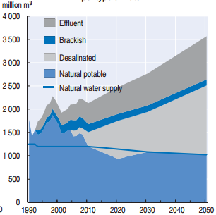
Water consumption projection - Israel
Source: OECD Environmental Performance Reviews: Israel 2011
Notes:
If we take a closer look into one of the countries in the most affected region (i.e. Israel in the Middle East), it is projected that the natural water supply will decrease over time (indicated by the solid blue line). To meet the increasing demand, desalinated and brackish water will have to be used, while effluent will have to be recycled and reused.

Slide 8
Desalination
Removal of minerals from saline water (i.e. brackish or seawater) to produce freshwater
Increasing importance in arid/semi-arid countries
Energy intensive process - hence an expensive option
Processes tend to need either input of thermal energy (e.g. multi-effect distillation) or electricity (reverse-osmosis)
Used in 150 countries (International Desalination Association, 2015)
86.8 million m³ per day
Serves more than 300 million people
Notes:
So, what is desalination? It is the process used to remove minerals from saline water so as to produce freshwater. This significance of desalination is increasing in arid and semi-arid countries.
It is an energy intensive and hence an expensive process. Energy inputs can be either in the form of thermal energy or electricity.
This is probably not well known, but desalination used in roughly 150 countries and in 2015 provided freshwater to more than 300 million people.

Slide 9
Main desalination technologies
Mechanical
Reverse Osmosis – a form of diffusion and occurs when two solutions of different concentrations are separated by means of a semipermeable membrane.
Thermal
Multi-stage Flash - based on vapour generation from seawater or brine as it enters a chamber (stage) which is at a lower pressure than its saturation pressure, causing flash evaporation.
Multi-effect Distillation – seawater is sprayed as a thin film and is distilled through a series of distillation steps.
Total worldwide
installed capacity by
technology (Pankratz 2014)
Notes:
There are different ways in which water can be desalinated. The most common is RO, as it takes up 65% of the share of the global desalinated water. This is a mechanical process in which the saline water is pushed through a semipermeable membrane, which collects the minerals but allows water to pass through.
Multi-stage Flash - based on vapour generation from seawater or brine as it enters a chamber (stage) which is at a lower pressure than its saturation pressure, causing flash evaporation, produced instantaneously and violently.
MED - The hot fluid (liquid or steam) transfers its energy to the seawater that is being sprayed over the first tube bundle row (feedwater), forming a thin film of water. The seawater is heated to its boiling point, evaporating part of it. The vapour generated flows to the condenser through a demister and there condenses, transferring its latent heat to the seawater circulating inside the condenser’s tube bundle. The demister stops brine droplets mixing with the generated vapour, or with the final product. Also, it prevents the condenser tube
bundle from being exposed to brine, thus avoiding scaling problems, tube corrosion and, as a consequence, a reduction in heat transfer.

Slide 10
Main desalination technologies
Multi-stage Flash
Reverse Osmosis
ELECTRICITY
HEAT
Multi-effect distillation (example of one effect)
Source: Palenzuela et al, 2015
Source: Fritzmann et al, 2007
Notes:
Explain the different processes and in the end indicate the difference in energy form inputs.

Slide 11
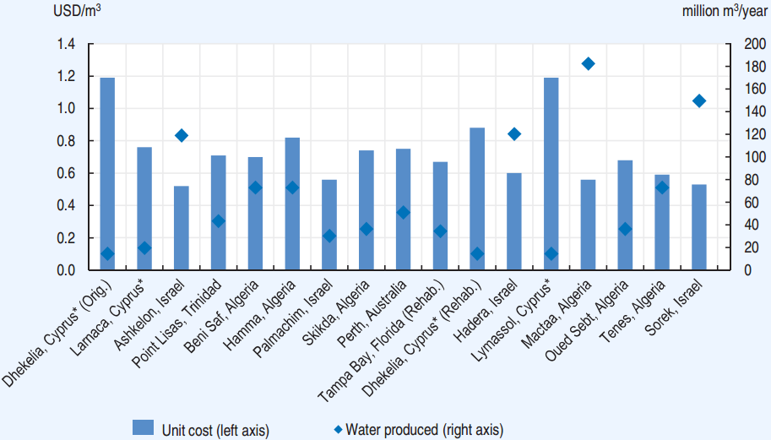
Desalinated seawater – reverse osmosis costs
Source: OECD Environmental Performance Reviews: Israel 2011
Notes:
The figure here shows cost of desalinated water from RO as well as the water output of different facilities across the world. Since RO relies on electricity, the cost varies according to the source and the cost of electricity. Desalination is an energy-intensive process and hence cost is relatively high. >>Important to note that this cost only takes into account production and not pumping or wastewater treatment.
Typical cost at household levels varies from a few cents/m3 to above $1/m3.

Slide 12
Coupling of RE with desalination?
Strong potential for co-benefits
Intermittency in RE generation can be accommodated with varying desalination output in reverse osmosis plants
Desalination as a form of storage in electricity systems
Direct use of solar heat – combined power and water
Source: Palenzuela et al, 2015
Notes:
Despite the high cost of water desalination, there is strong potential for co-benefits with vRE.
Reverse osmosis can be an option for vRE generating electricity (e.g. PV and wind). Rapid fluctuations in vRE generation can be accommodated by varying the output of RO plants. This though can affect the lifetime of membranes.
CSP can be coupled with desalination technologies that require heat (multi-effect distillation, multi-stage flash)

Slide 13
Solar still and Desalination
Source: Abutayeh et al, 2014
Notes:
The use of solar energy does not necessitate complex equipment. Solar stills can be deployed to produce freshwater in low quantities. (explain top left and bottom figures).
These options are not new, but could be deployed in remote small communities that have no access to freshwater (e.g. small islands).

Slide 14
Solar PV and Reverse Osmosis
Source: Al-Karaghouli and Kazmerski, 2011
Notes:
This figure shows a simple setup making use of PV panels and reverse osmosis. (describe). This setup could be arranged in multiple sizes, while the electricity source could be other RE as well (such as wind or tidal)

Slide 15
CSP and Multi-Stage Flash
Source: Abutayeh et al, 2014
Notes:
In the last example, we can see how CSP can be used to produce freshwater and generate electricity simultaneously.
(Explain figure by starting from the solar collector’s and storage blocks)

Slide 16
Suggested further reading
The Future of Seawater Desalination: Energy, Technology, and the Environment http://science.sciencemag.org/content/333/6043/712.full
Desalination using renewable energy sources on the arid islands of South Aegean Sea http://www.sciencedirect.com/science/article/pii/S0360544215015248

Slide 17
Changelog and attribution
Date | Author | Reviewer | Reviser
2017-10-10 | Constantinos Taliotis | Agnese Beltramo | Constantinos Taliotis
To correctly reference this work, please use the following:
Taliotis, C., 2017. New Trends in Energy – Desalination, OpTIMUS.community. Available at: http://www.osemosys.org/understanding-the-energy-system.html. [Access date]

